Slide 1
Modern Systems Analysis and Design
Chapter 1
The Systems Development Environment

Slide 2
Learning Objectives
Define information systems analysis and design.
Describe the information Systems Development Life Cycle (SDLC).
Explain Rapid Application Development (RAD), prototyping, Computer Aided Software Engineering (CASE).
Describe agile methodologies and eXtreme programming.
Explain Object Oriented Analysis and Design and the Rational Unified Process (RUP).

Slide 3
Introduction
Information Systems Analysis and Design
Complex organizational process
Used to develop and maintain computer-based information systems
Used by a team of business and systems professionals

Slide 4
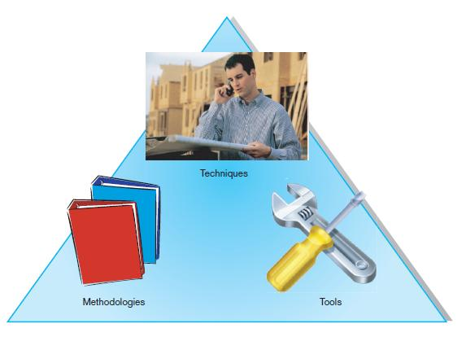
Introduction (Cont.)
An organizational approach to systems analysis and design is driven by methodologies, techniques, and tools

Slide 5
Developing Information Systems
System Development Methodology is a standard process followed in an organization to conduct all the steps necessary to analyze, design, implement, and maintain information systems.

Slide 6
Systems Development Life Cycle (SDLC)
Traditional methodology used to develop, maintain, and replace information systems.
Phases in SDLC:
Planning
Analysis
Design
Implementation
Maintenance

Slide 7
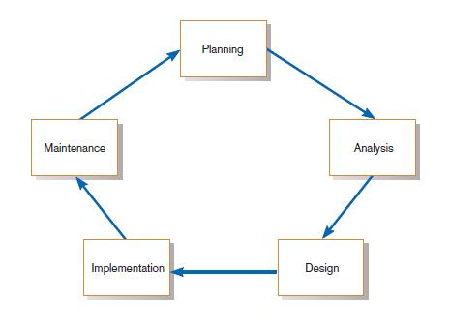
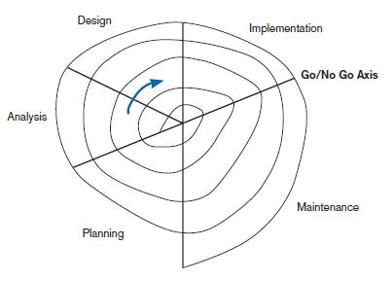
Standard and Evolutionary Views of SDLC
FIGURE 1-3 Evolutionary model
FIGURE 1-2
The systems development life cycle

Slide 8
Systems Development Life Cycle (SDLC) (Cont.)
Planning – an organization’s total information system needs are identified, analyzed, prioritized, and arranged
Analysis – system requirements are studied and structured

Slide 9
Systems Development Life Cycle (SDLC) (Cont.)
Design – a description of the recommended solution is converted into logical and then physical system specifications
Logical design – all functional features of the system chosen for development in analysis are described independently of any computer platform

Slide 10
Systems Development Life Cycle (SDLC) (Cont.)
Physical design – the logical specifications of the system from logical design are transformed into the technology-specific details from which all programming and system construction can be accomplished

Slide 11
Systems Development Life Cycle (SDLC) (Cont.)
Implementation – the information system is coded, tested, installed and supported in the organization
Maintenance – an information system is systematically repaired and improved

Slide 12
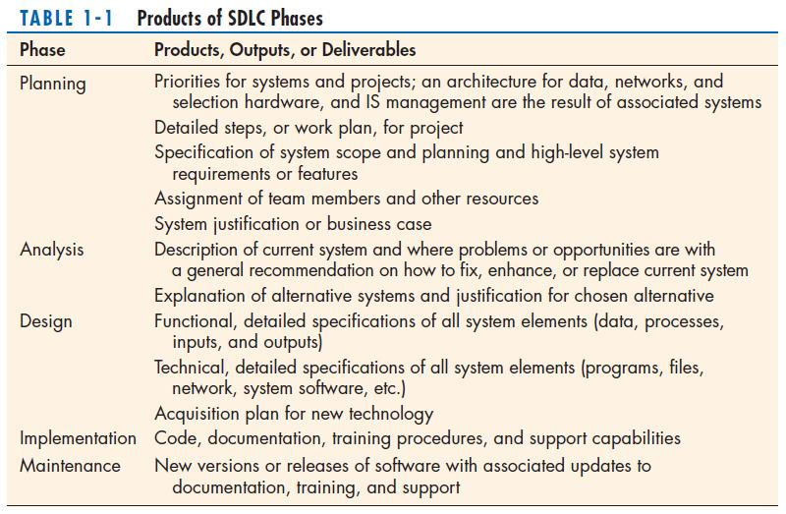

Slide 13
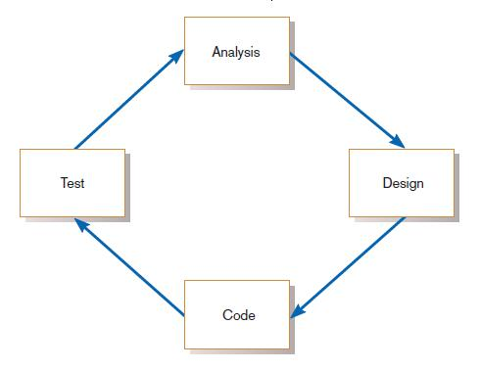
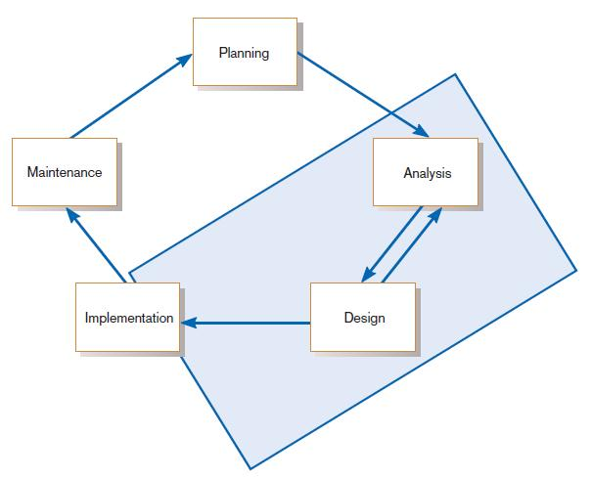
The Heart of the Systems Development Process
FIGURE 1-7
The analysis–design–code–test loop
Current practice combines analysis, design, and implementation into a single iterative and parallel process of activities.

Slide 14
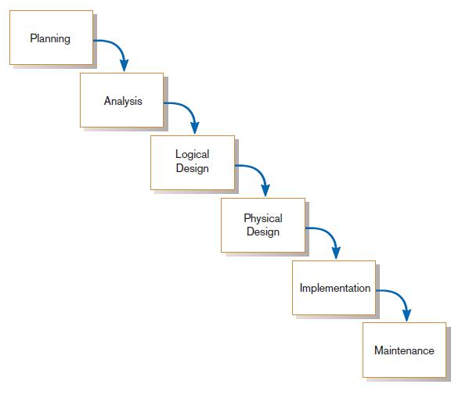
Traditional Waterfall SDLC
One phase begins when another completes, with little backtracking and looping.
FIGURE 1-9
A traditional waterfall SDLC

Slide 15
Problems with Waterfall Approach
System requirements “locked in” after being determined (can't change)
Limited user involvement (only in requirements phase)
Too much focus on milestone deadlines of SDLC phases to the detriment of sound development practices

Slide 16
Different Approaches to Improving Development
Prototyping
CASE Tools
Joint Application Design (JAD)
Rapid Application Development (RAD)
Agile Methodologies
eXtreme Programming
Rational Unified Process (RUP)

Slide 17
Prototyping
Prototyping
Is a form of Rapid Application Development.
Building a scaled-down working version of the system
Advantages:
Users are involved in design
Captures requirements in concrete form

Slide 18
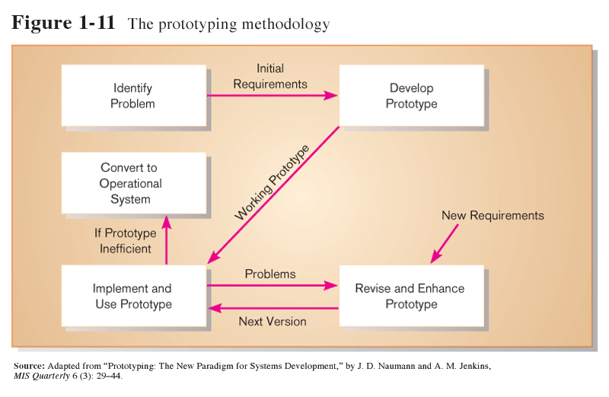
Prototyping (Cont.)

Slide 19
Computer-Aided Software Engineering (CASE) Tools
Diagramming tools enable graphical representation.
Computer displays and report generators help prototype how systems “look and feel”.

Slide 20
Computer-Aided Software Engineering (CASE) Tools (Cont.)
Analysis tools automatically check for consistency in diagrams, forms, and reports.
A central repository provides integrated storage of diagrams, reports, and project management specifications.

Slide 21
Computer-Aided Software Engineering (CASE) Tools (Cont.)
Documentation generators standardize technical and user documentation.
Code generators enable automatic generation of programs and database code directly from design documents, diagrams, forms, and reports.

Slide 22
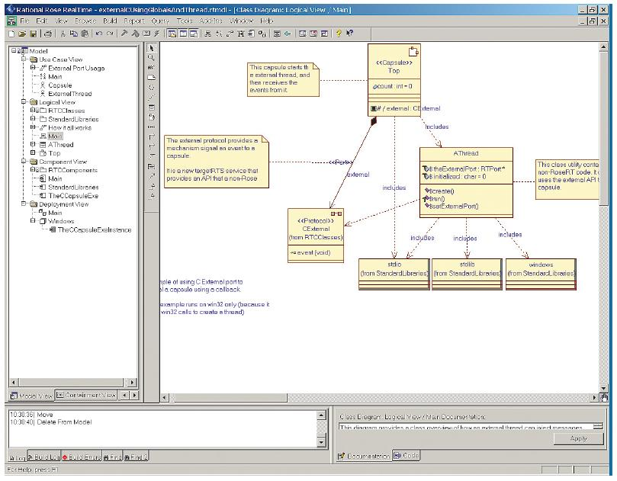
CASE Tools (Cont.)
FIGURE 1-10
A class diagram from IBM’s Rational Rose
(Source: IBM)

Slide 23
CASE Tools (Cont.)

Slide 24
Joint Application Design (JAD)
Structured process involving users, analysts, and managers.
Several-day intensive workgroup sessions.
Purpose:
To specify or review system requirements.
To review system designs.

Slide 25
Rapid Application Development (RAD)
Methodology to radically decrease design and implementation time
Involves: extensive user involvement, prototyping, JAD sessions, integrated CASE tools, and code generators

Slide 26
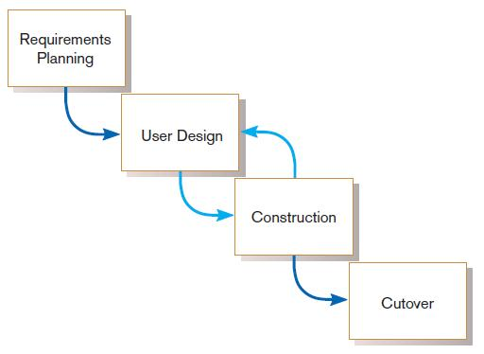
Rapid Application Development (RAD) (Cont.)
FIGURE 1-11
RAD life cycle

Slide 27
Agile Methodologies
Motivated by recognition of software development as fluid, unpredictable, and dynamic
Three key principles
Adaptive rather than predictive
Emphasize people rather than roles
Self-adaptive processes

Slide 28
When to use Agile Methodologies
If your project involves:
Unpredictable or dynamic requirements
Responsible and motivated developers
Customers who understand the process and will get involved

Slide 29
eXtreme Programming
Short, incremental development cycles
Automated tests
Two-person programming teams

Slide 30
eXtreme Programming (Cont.)
Coding and testing operate together
Advantages:
Communication between developers
High level of productivity
High-quality code

Slide 31
Object-Oriented Analysis and Design (OOAD)
Based on objects rather than data or processes
Object: a structure encapsulating attributes and behaviors of a real-world entity

Slide 32
Object-Oriented Analysis and Design (OOAD) (Cont.)
Object class: a logical grouping of objects sharing the same attributes and behaviors
Inheritance: hierarchical arrangement of classes enable subclasses to inherit properties of superclasses

Slide 33
Rational Unified Process (RUP)
An object-oriented systems development methodology
RUP establishes four phase of development: inception, elaboration, construction, and transition.
Each phase is organized into a number of separate iterations.

Slide 34
Chapter 3
Managing the Information Systems Project

Slide 35
Importance of Project Management
Project management may be the most important aspect of systems development.
Effective PM helps to ensure
Meeting customer expectations.
Satisfying budget and time constraints.
PM skills are difficult and important to learn.

Slide 36
Deciding on Systems Projects
System Service Request (SSR)
A standard form for requesting or proposing systems development work within an organization

Slide 37
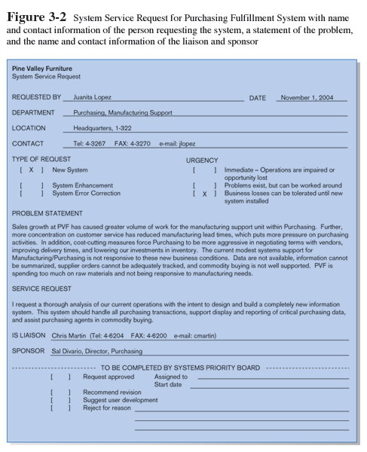
System Service Request (SSR) is a form requesting development or maintenance of an information system. It includes the contact person, a problem statement, a service request statement, and contact information

Slide 38
Deciding on Systems Projects
Feasibility study
A study that determines whether a requested system makes economic and operational sense for an organization

Slide 39
Managing the Information Systems Project
Project
A planned undertaking of related activities to reach an objective that has a beginning and an end
Project management
A controlled process of initiating, planning, executing, and closing down a project
Deliverable
An end product of an SDLC phase

Slide 40
Managing the Information Systems Project (cont.)
Project manager
Systems analyst with management and leadership skills responsible for leading project initiation, planning, execution, and closedown

Slide 41
Phases of Project Management Process
Phase 1: Initiation
Phase 2: Planning
Phase 3: Execution
Phase 4: Closedown

Slide 42
PM Phase 1: Project Initiation
Project manager performs several activities to:
Assess size, scope and complexity of project, and establish procedures to support activities.
Establish:
Project Initiation team
Relationship with customer
Project initiation plan
Agendas for several meetings
Management procedures
Developing team communication, reporting procedures, job assignments and roles, project change procedures, funding and billing procedures
Project management environment
Collect used tools of project management.
Project workbook
Recording project information

Slide 44
PM Phase 2: Project Planning
Define clear, discrete activities and the work needed to complete each activity
Tasks
Describe project scope, alternatives, feasibility
Understand content and complexity
Divide project into tasks: work breakdown structure (phases, activities, tasks)
Estimate resource requirements (people, money)
Methods for estimating project size: COCOMO (COnstructive COst MOdel), Function point estimating
Develop preliminary schedule
Develop communication plan
Determine standards and procedures
Risk identification and assessment
Create preliminary budget
Develop a statement of work
Set baseline project plan

Slide 45
Some Components of Project Planning
Work Breakdown Structure (WBS)
Division of project into manageable and logically ordered tasks and subtasks.
Preliminary Budget
Cost-benefit analysis outlining planned expenses and revenues.
Statement of Work (SOW)
“Contract” between the IS staff and the customer regarding deliverables and time estimates for a system development project.

Slide 46
Some Components of Project Planning (cont.)
The Baseline Project Plan (BPP)
Provides an estimate of scope, benefits, schedules, costs, risks, and resource requirements.
Scheduling Diagrams
Gantt chart: horizontal bars represent task durations
Network diagram: boxes and links represent task dependencies

Slide 47
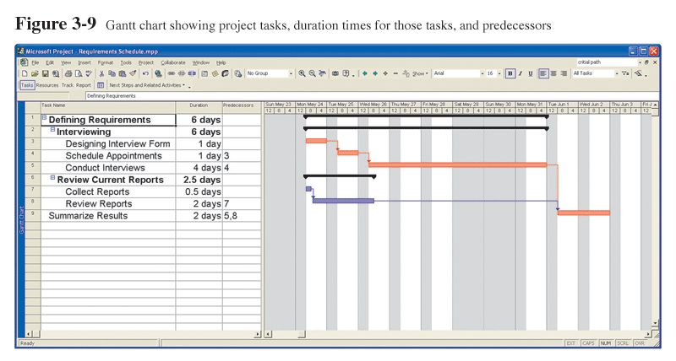
Scheduling Diagrams Gantt Chart
Special-purpose project management software is available for this.

Slide 48
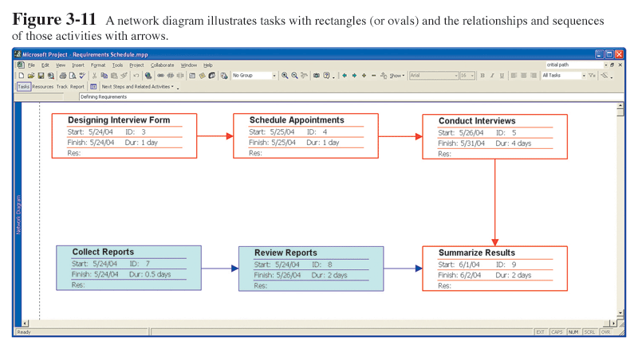
Scheduling Diagrams Network Diagram
Special-purpose project management software is available for this.

Slide 49
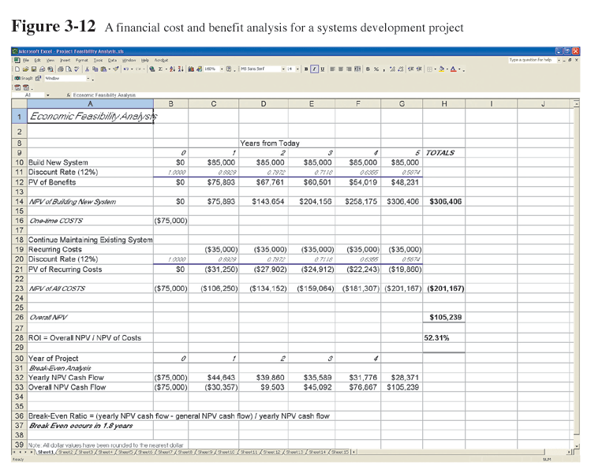
Preliminary Budget
Spreadsheet software is good for this.

Slide 50
PM Phase 3: Project Execution
Plans created in prior phases are put into action.
Actions
Execute baseline project plan
Monitor progress against baseline plan
Manage changes in baseline plan
Maintain project workbook
Communicate project status

Slide 51
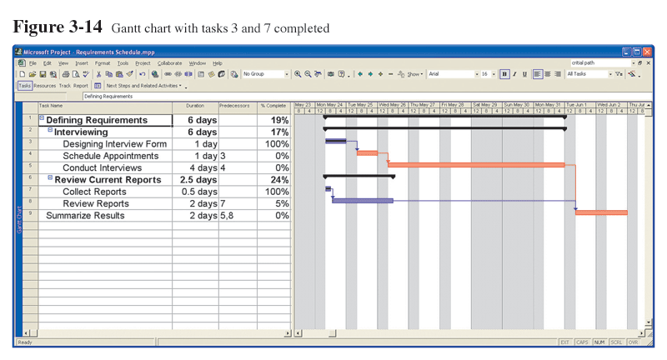
Monitoring Progress with a Gantt Chart
Red bars indicate critical path, lines through bars indicate percent complete.

Slide 52
Communication Methods
Project workbook
Meetings
Seminars and workshops
Newsletters
Status reports
Specification documents
Minutes of meetings
Bulletin boards
Memos
Brown bag lunches
Hallway discussions

Slide 53
PM Phase 4: Project Closedown
Bring the project to an end.
Actions
Close down the project.
Conduct post-project reviews.
Close the customer contract.

Slide 54
Representing and Scheduling Project Plans
Gantt Charts
Network Diagrams
PERT Calculations
Critical Path Scheduling
Project Management Software

Slide 55
Gantt Charts vs. Network Diagrams
Gantt charts
Show task durations.
Show time overlap.
Show slack time in duration.
Network diagrams
Show task dependencies.
Do not show time overlap, but show parallelism.
Show slack time in boxes.

Slide 56
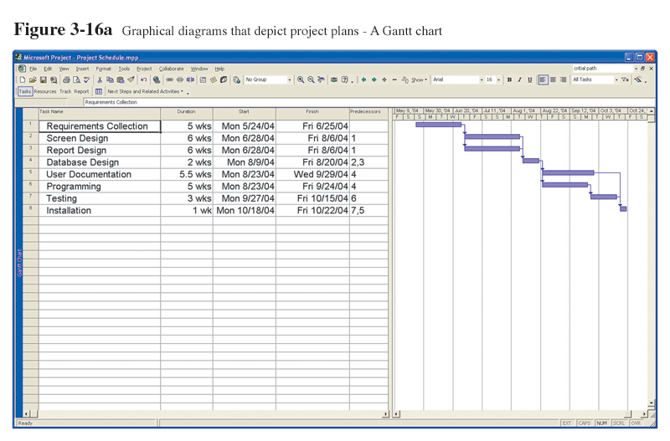
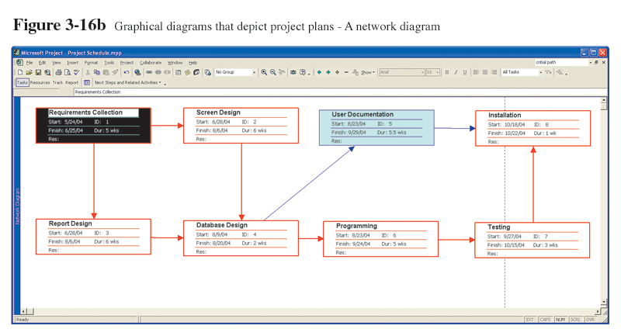
Gantt Charts vs. Network Diagrams (cont.)

Slide 57
Estimating Task Duration
PERT: Program Evaluation Review Technique
Technique that uses optimistic (o), pessimistic (p), and realistic (r) time estimates to determine expected task duration
Formula for Estimated Time:
ET = (o + 4r + p)/6

Slide 58
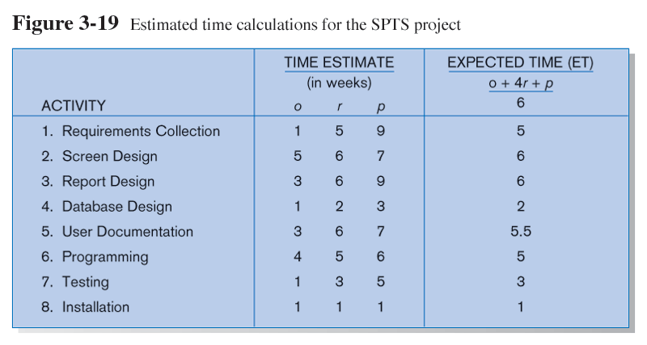
Example PERT Analysis

Slide 59
Critical Path Scheduling
A scheduling technique whose order and duration of a sequence of task activities directly affects the completion date of a project
Critical path: the shortest time in which a project can be completed
Slack time: the time an activity can be delayed without delaying the project

Slide 60
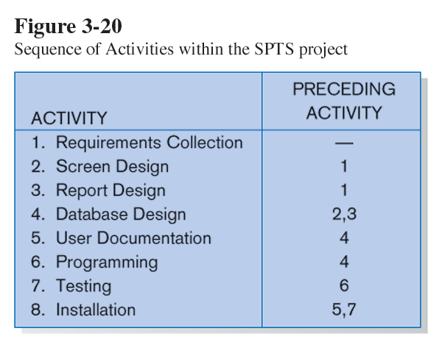
Critical Path Example (dependencies between tasks)
PRECEDING ACTIVITIES indicate the activities that must be completed before the specified activity can begin (see Fig. 3.19 for time estimates).

Slide 61
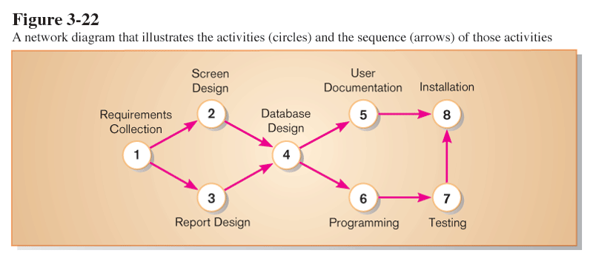
Critical Path Example
Network diagram shows dependencies
Network diagram provides graphical illustration of dependencies between activities (see previous slide).

Slide 62
Determining the Critical Path
Calculate the earliest possible completion time for each activity by summing the activity times in the longest path to the activity. This gives total expected project time.
Calculate the latest possible completion time for each activity by subtracting the activity times in the path following the activity from the total expected time. This gives slack time for activities.
Critical path – contains no activities with slack time.

Slide 63
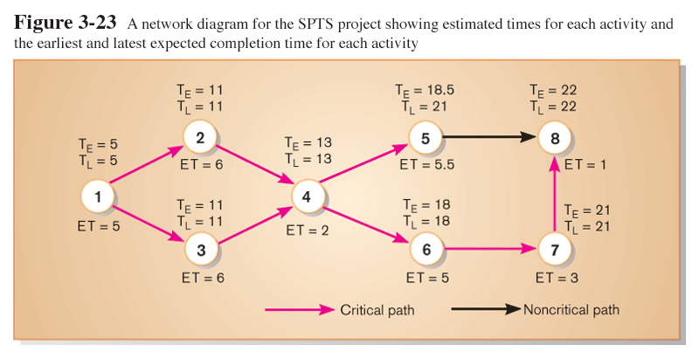
Critical Path Calculation
Early and late time calculations are determined and critical path established. (Note: Activity #5 can begin late without affecting project completion time).

Slide 64
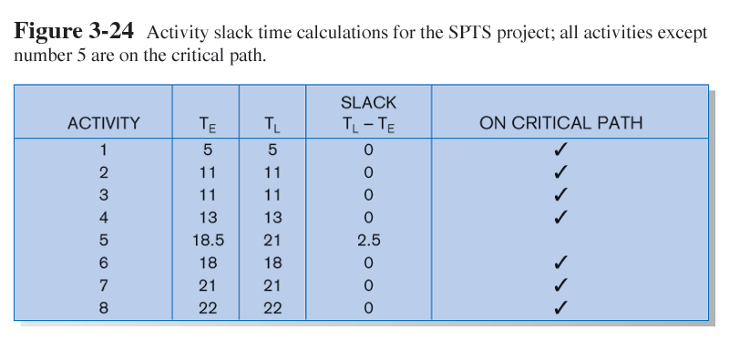
Critical Path Calculation (cont.)
Note the slack time in Activity #5.

Slide 65
Using Project Management Software
Many powerful software tools exist for assisting with project management.
Example: Microsoft Project can help with
Entering project start date.
Establishing tasks and task dependencies.
Viewing project information as Gantt or Network diagrams.

Slide 66
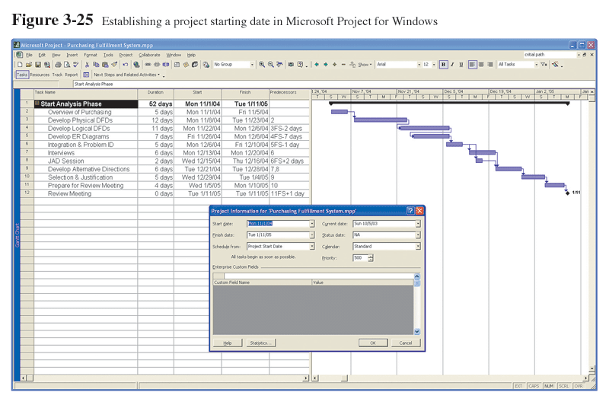
Project Start Date

Slide 67
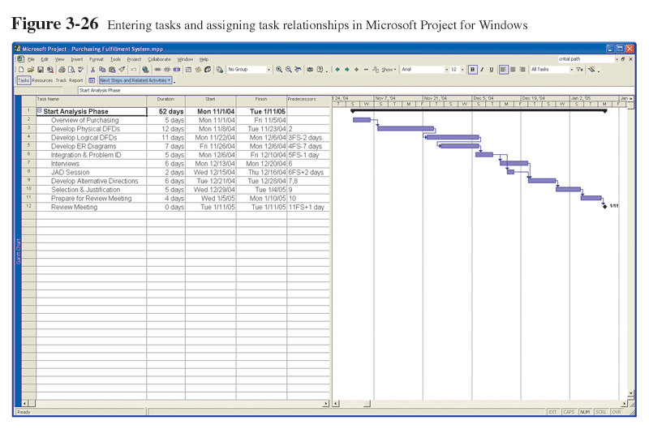
Entering Tasks

Slide 68
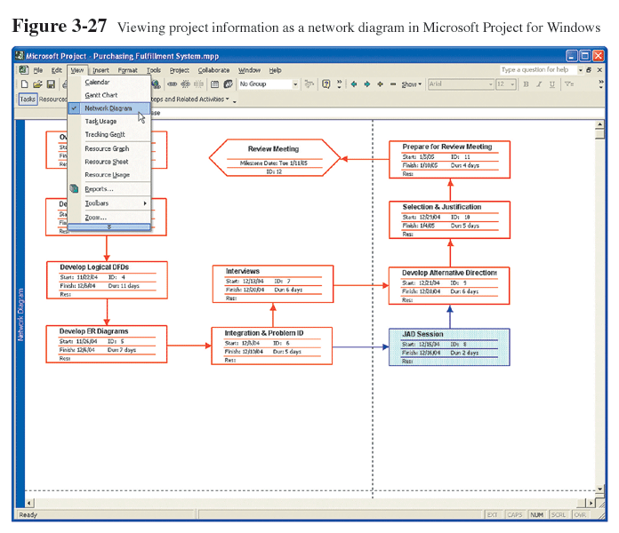
Viewing Network Diagram
Hexagon shape indicates a milestone.
Red boxes and arrows indicate critical path (no slack).

Slide 69
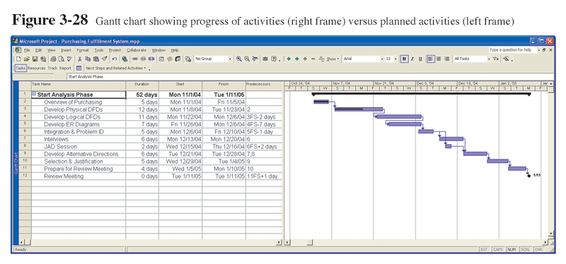
Viewing Gantt Chart
Black line at top indicates a summary activity (composed of subtasks).
Diamond shape indicates a milestone.

